Slide 1

Tallos Wallet
Mobile app presentation

Slide 2
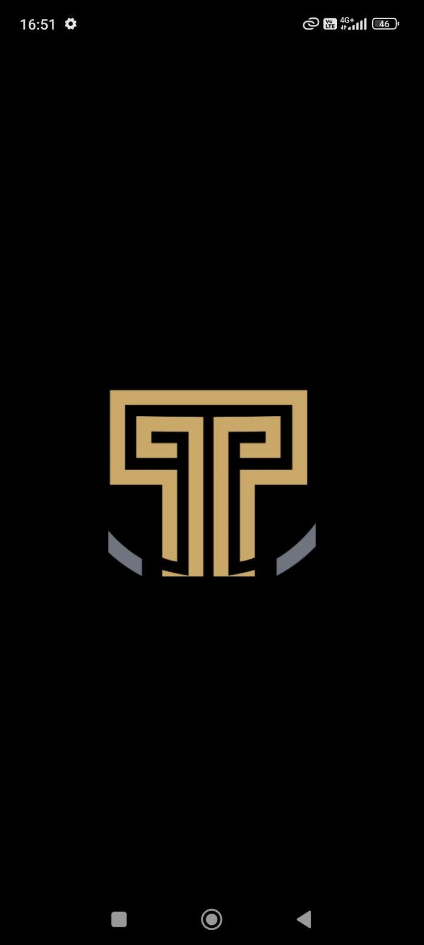
Tallos wallet consumer mobile app
Mobile app for wallet payments
For consumer networks & communities
iOS and Android
Very simple in its use
Clean processes
Clear messages
Ease of use for any user demographic

Slide 3
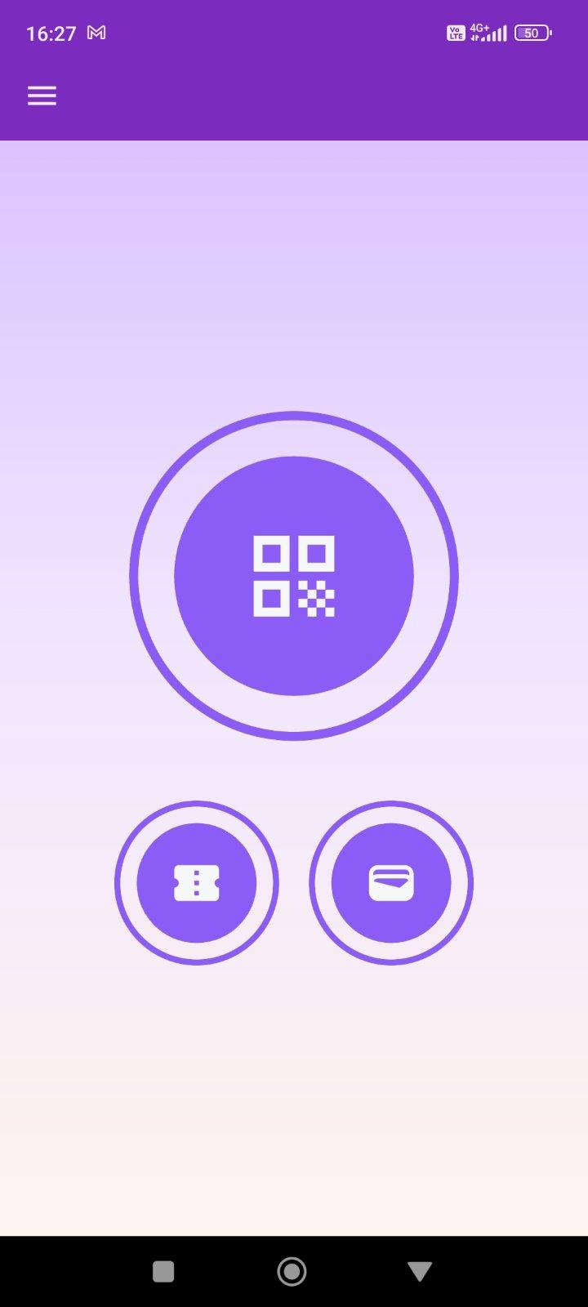


Tallos wallet consumer mobile app
At app startup
Main button for user profile QR (membership)
Wallet button

Slide 4
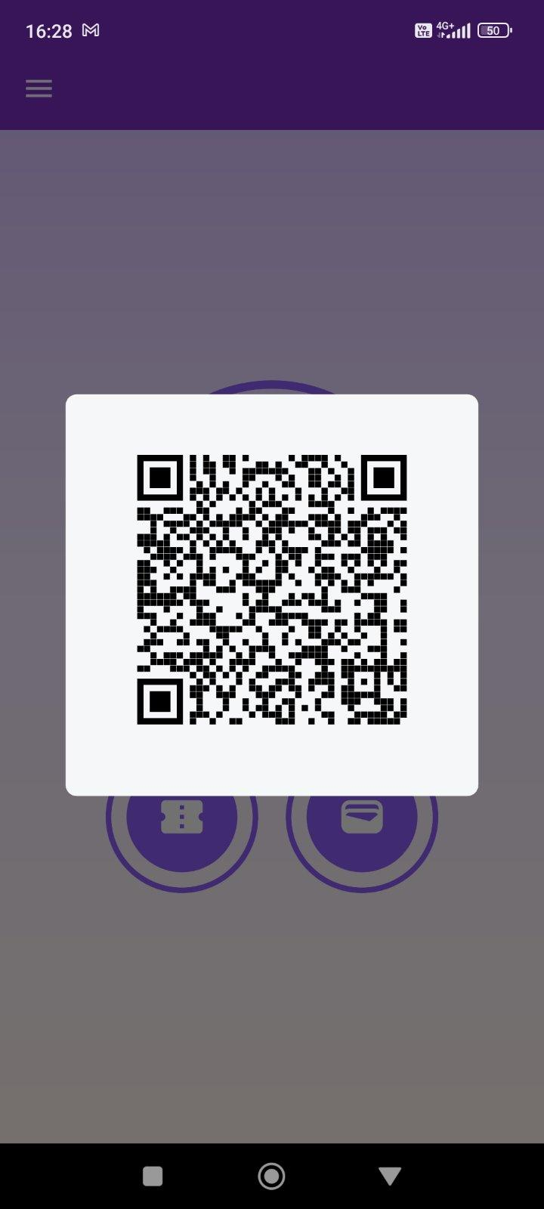
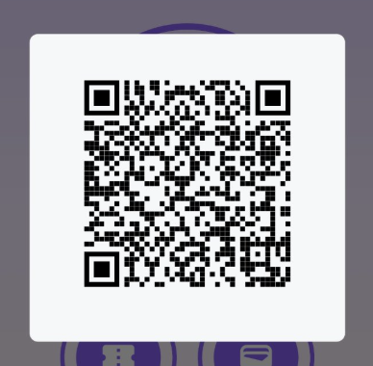
Tallos wallet consumer mobile app
User profile QR
For network / community ID

Slide 5
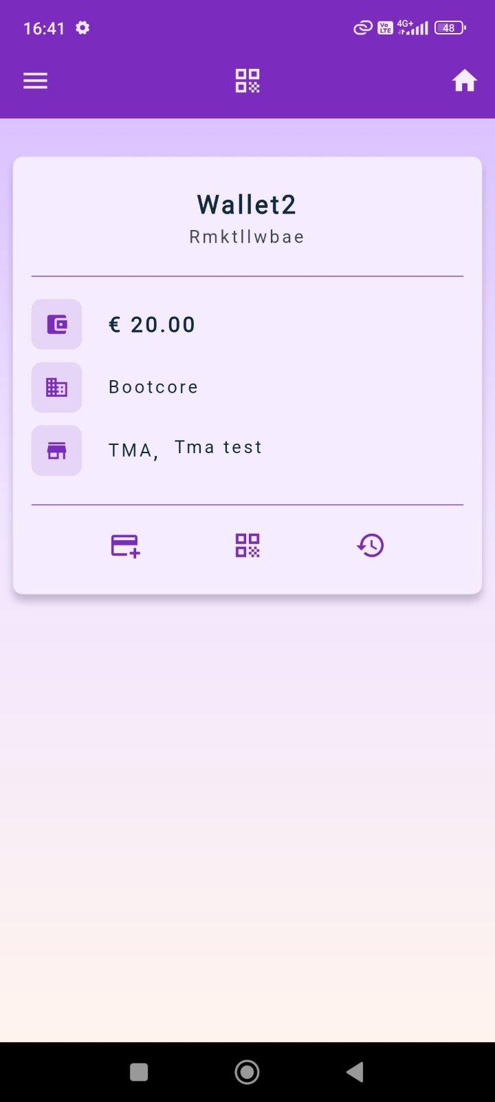






Tallos wallet consumer mobile app
Total wallet sum
Name of payment provider
Wallet POSs
Add money
Payment transactions QR
Transactions history

Slide 6
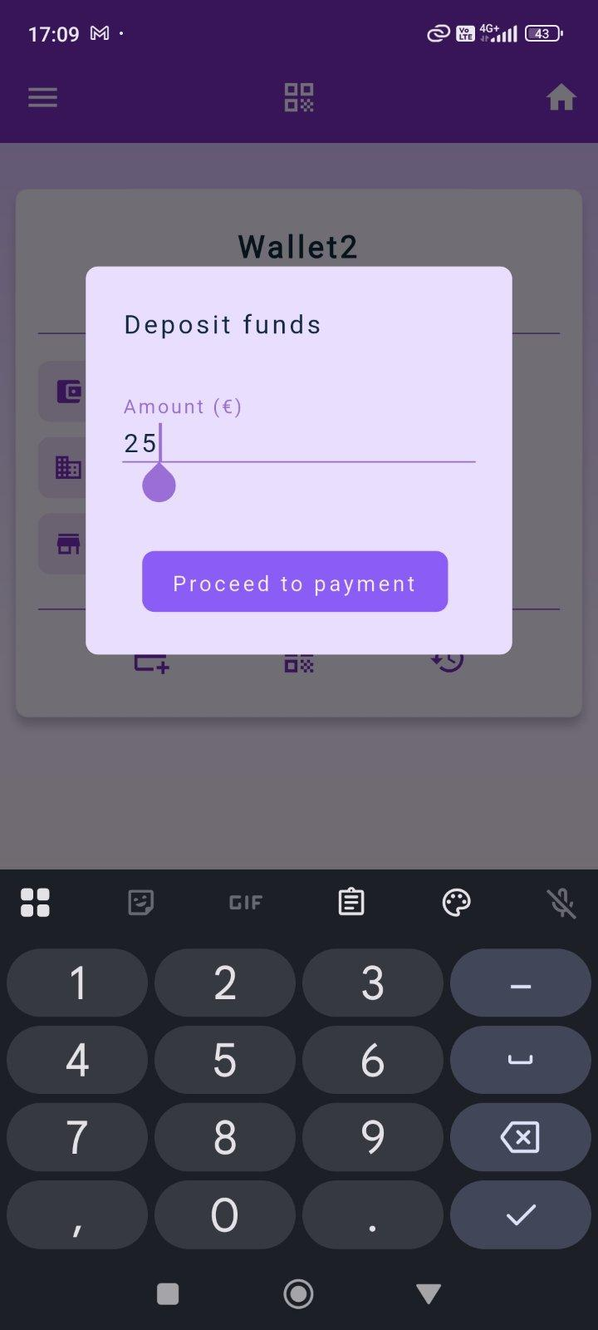
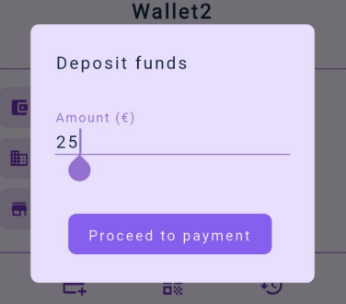
Tallos wallet consumer mobile app
Fill up your own personal wallet

Slide 7
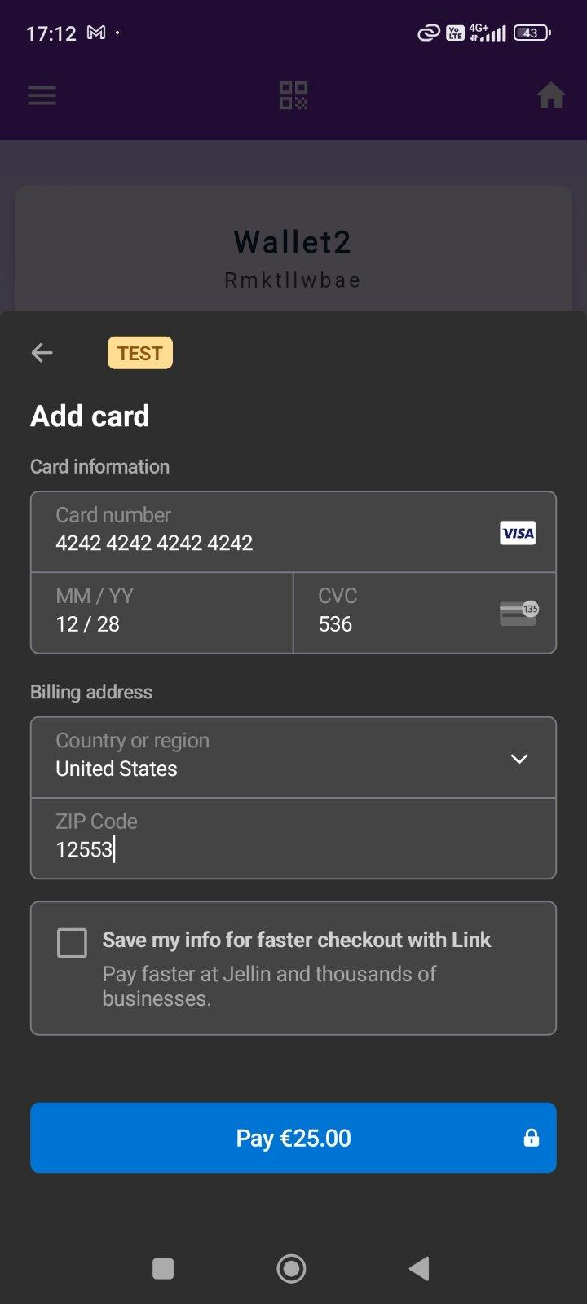
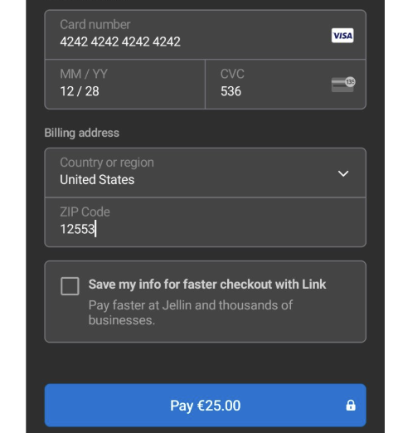
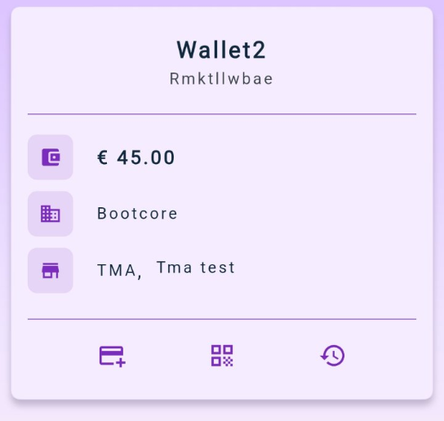
Tallos wallet consumer mobile app
Direct money transfer via your payment gateway

Slide 8
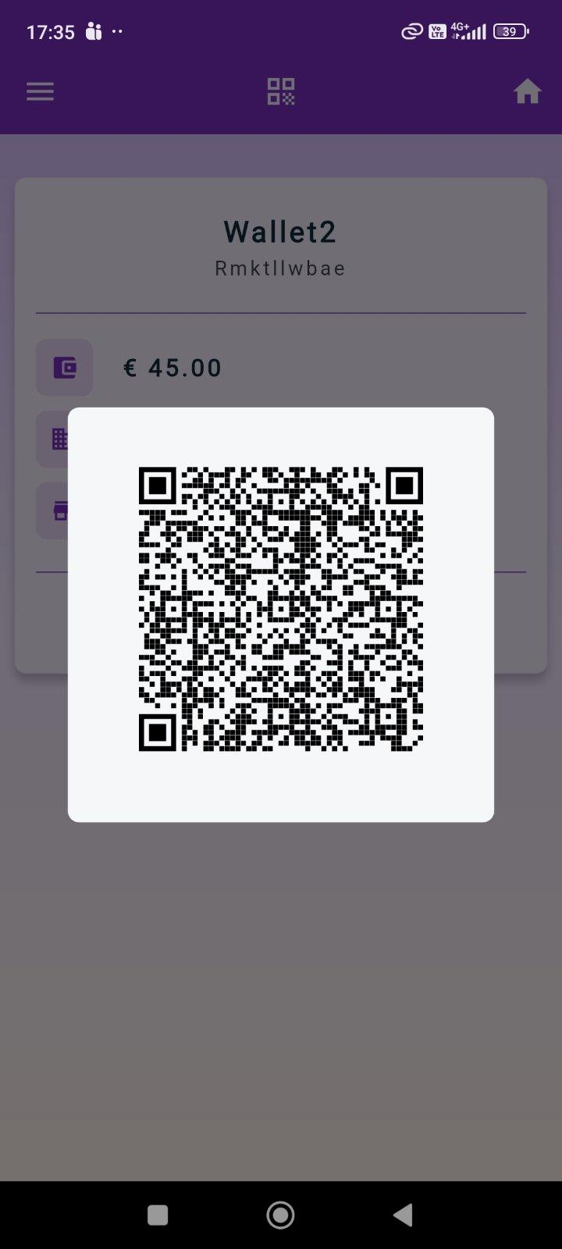
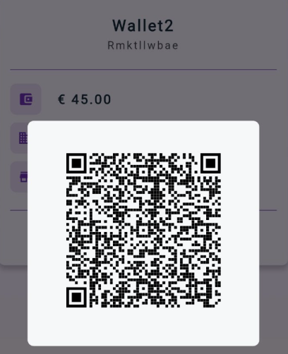
Tallos wallet consumer mobile app
Payment transactions QR

Slide 9
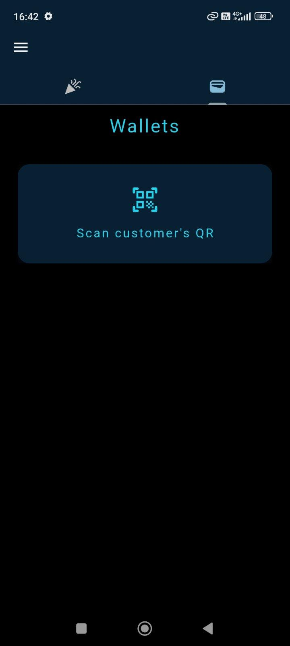
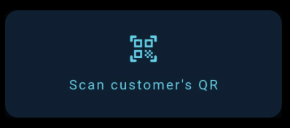
POS side for payments (demo app)
QR based transaction
Can also be NFC based transaction

Slide 10
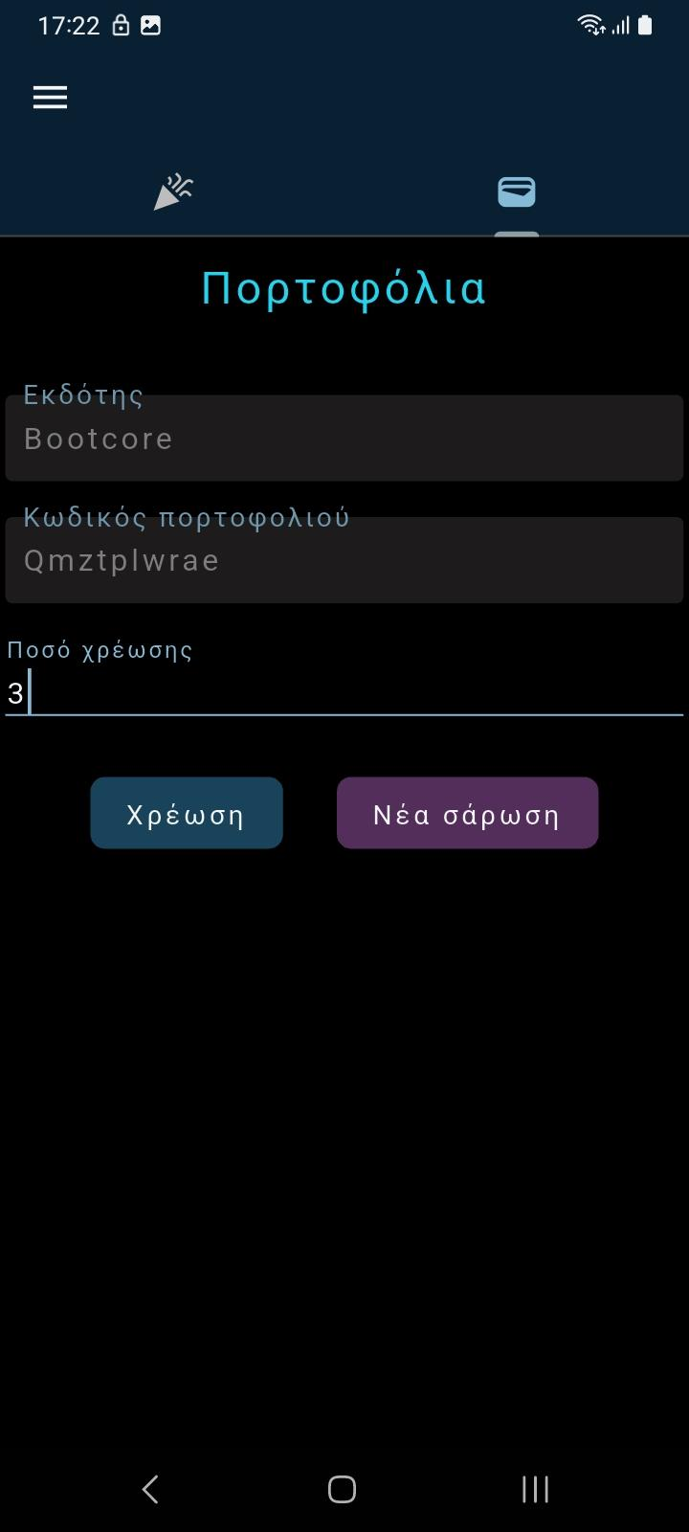
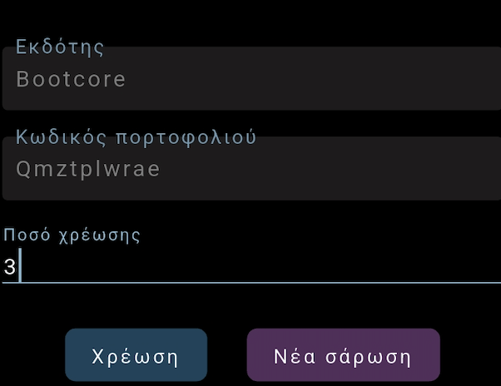
POS side for payments (demo app)
Wallet as a payment option at POS
Entire sum or sub sum payment

Slide 11
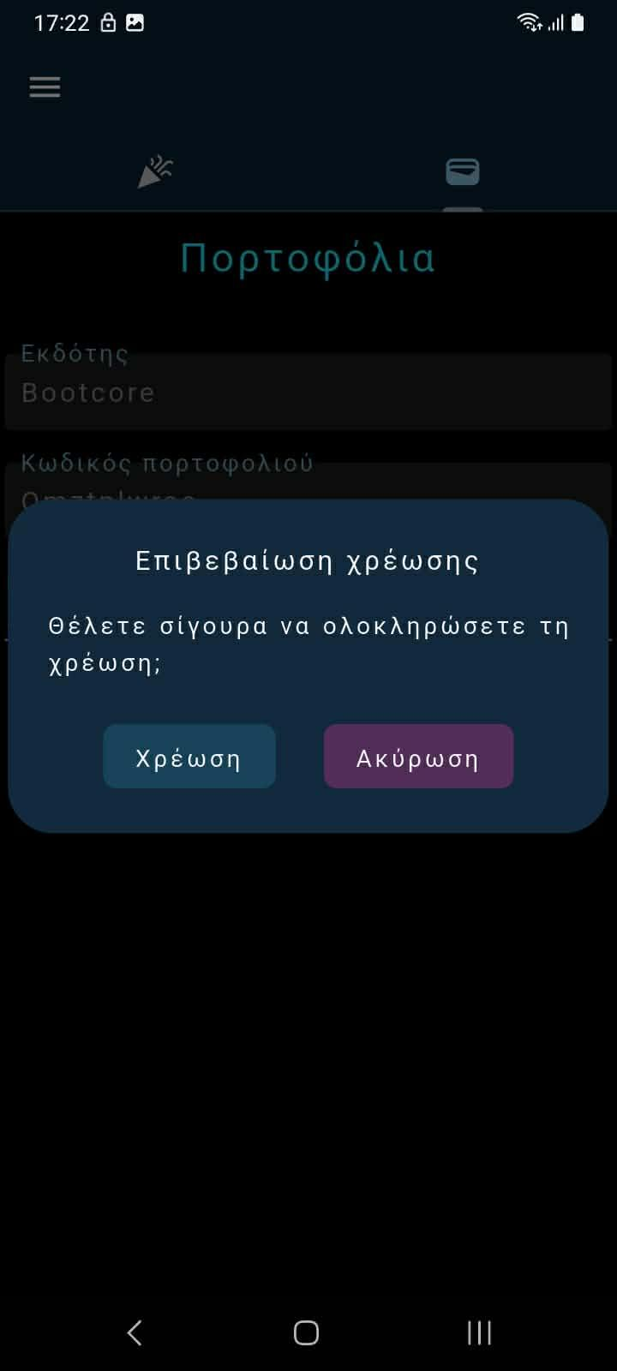
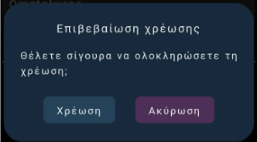
POS side for payments (demo app)
Fully reversible actions

Slide 12
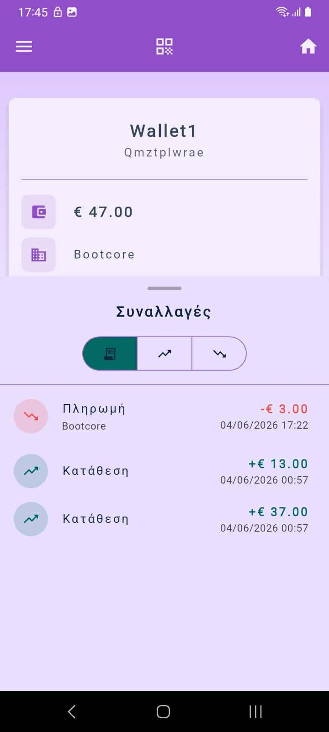
Tallos wallet consumer mobile app
Wallet transactions history
Payments
Deposits
Both

Slide 13
Tallos Wallet
Thank You

